Slide 1
Leaf sorting game

Slide 2
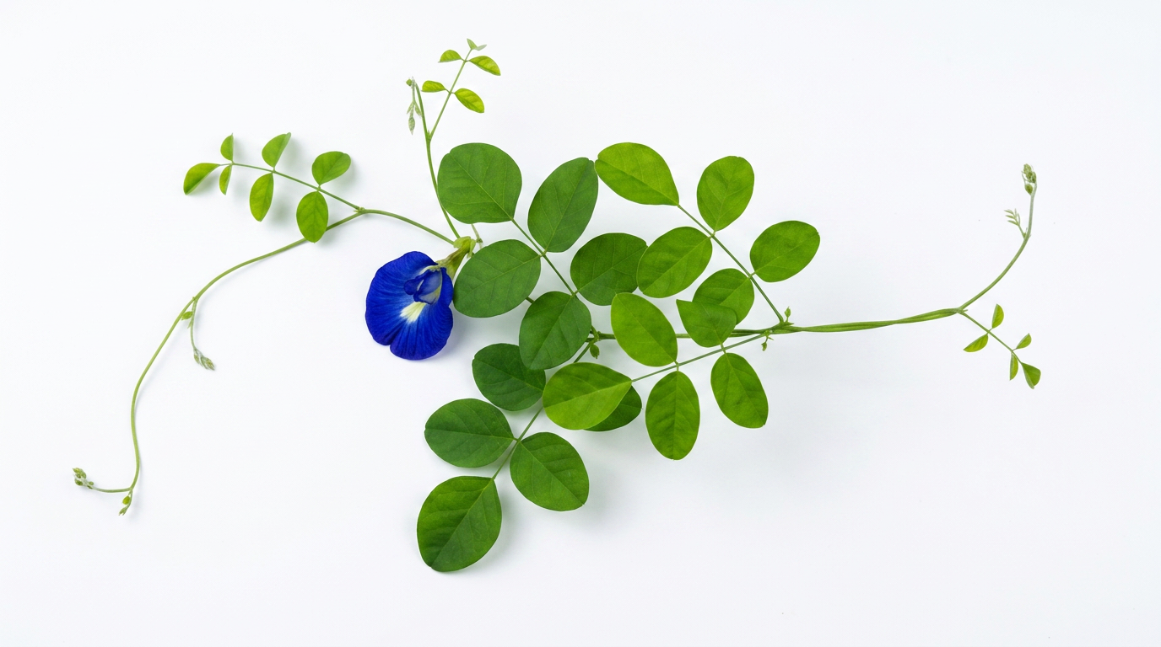
Butterfly Pea

Slide 3
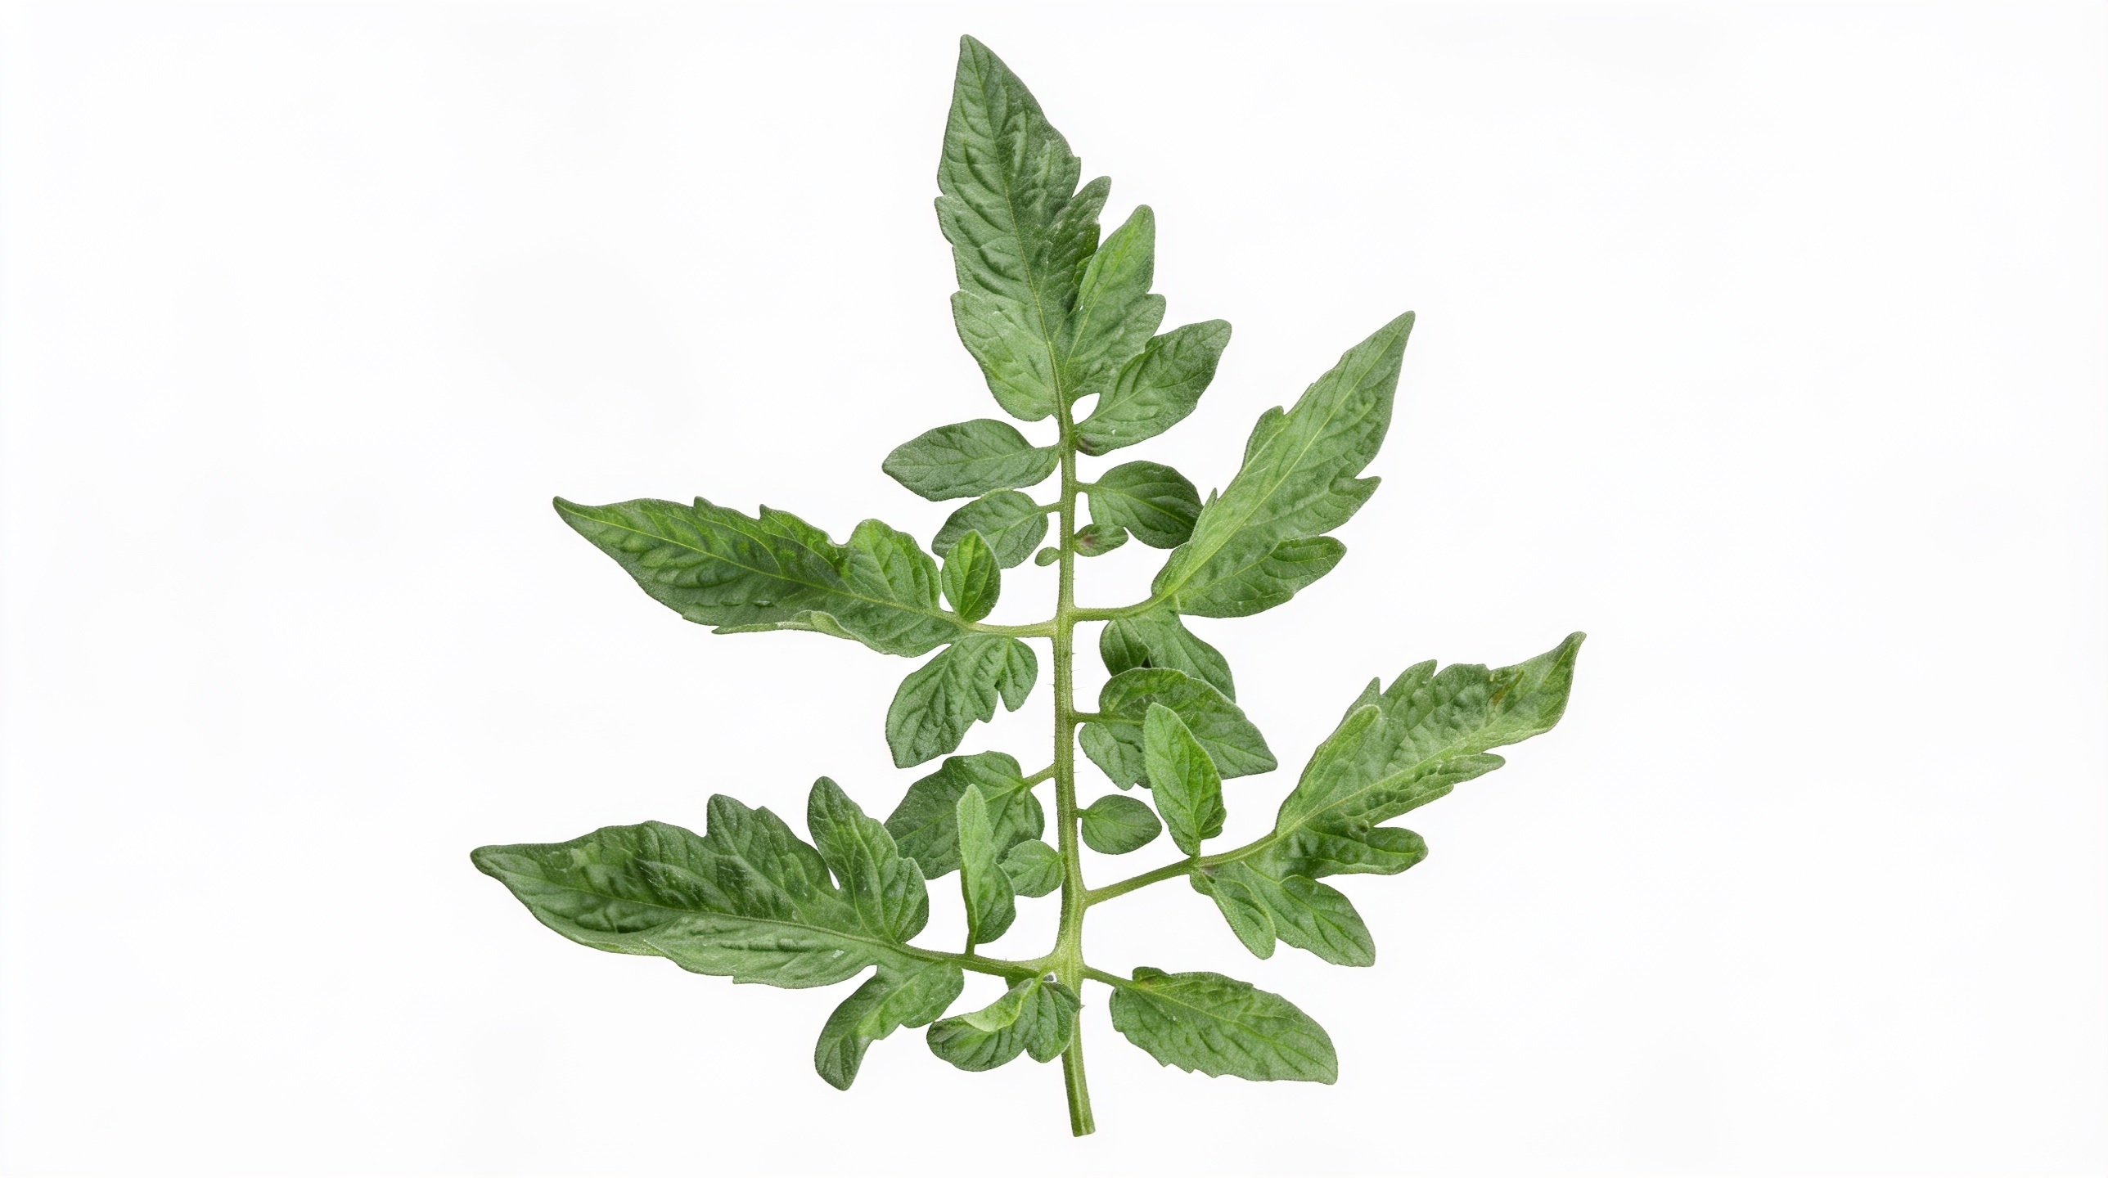
Tomato

Slide 4
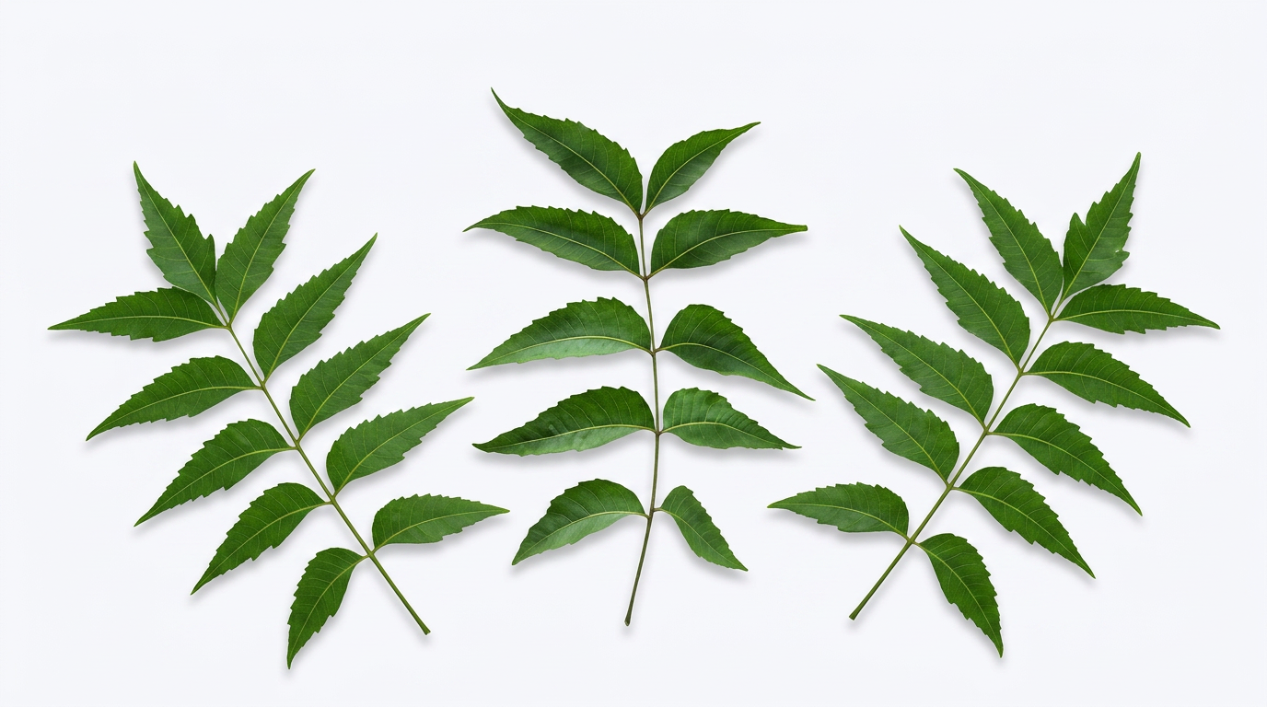
Neem

Slide 5

Curry leaf

Slide 6

Rain tree

Slide 7
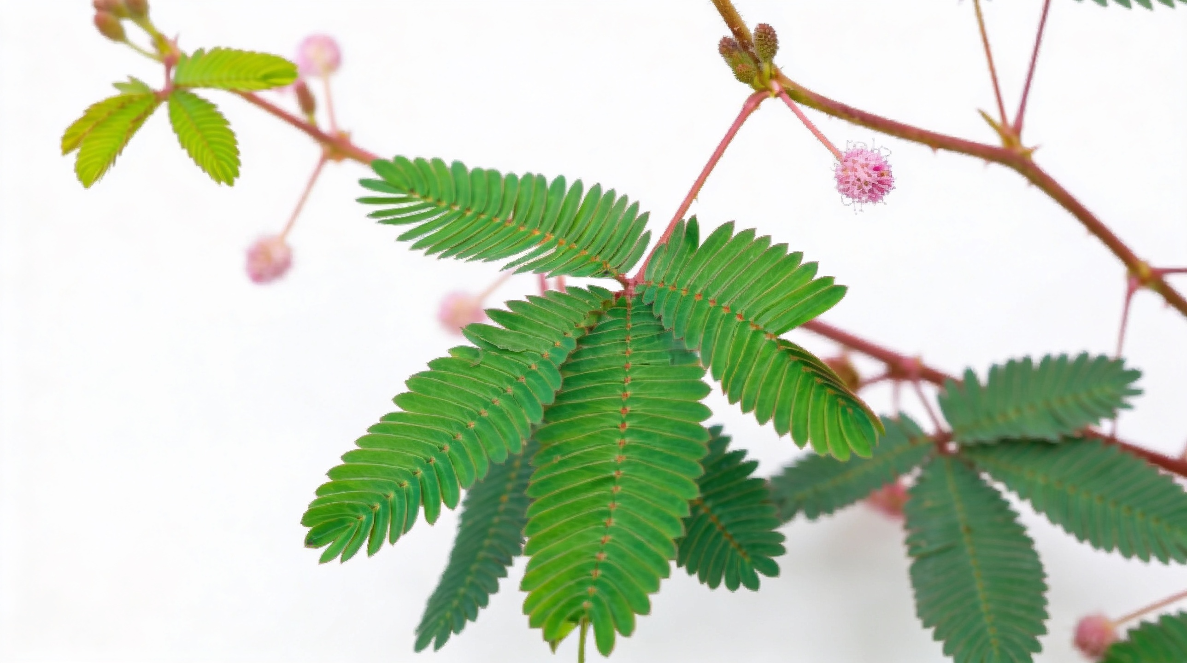
Touch me not

Slide 8
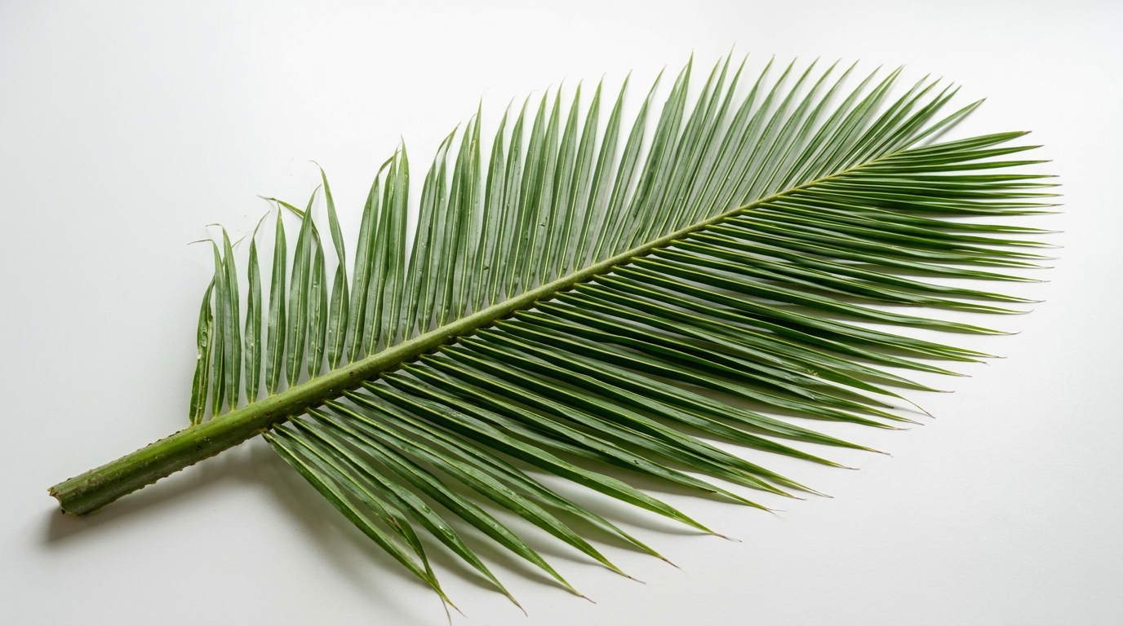
Coconut

Slide 9

Marijuana

Slide 10
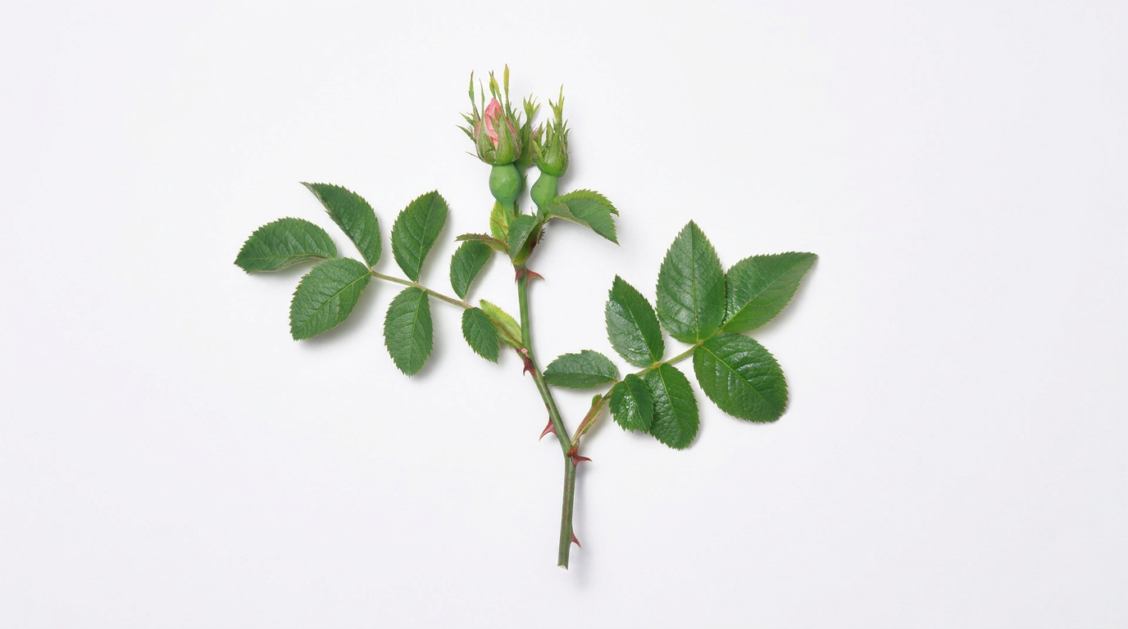
Rose

